Slide 2
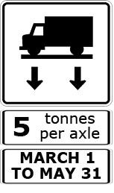
Using LTPP Data to Develop Spring Load Restrictions

Slide 3
Using LTPP Data to Develop Spring Load Restrictions
Thawing Index (TI)
Indicates the progression of thaw in pavement
Indicates the beginning of weakening and eventual damage in pavement
Used to set spring load restrictions (SLR)
Use the air and asphalt temperature data from LTPP InfoPave to calculate the thawing index.

Slide 4
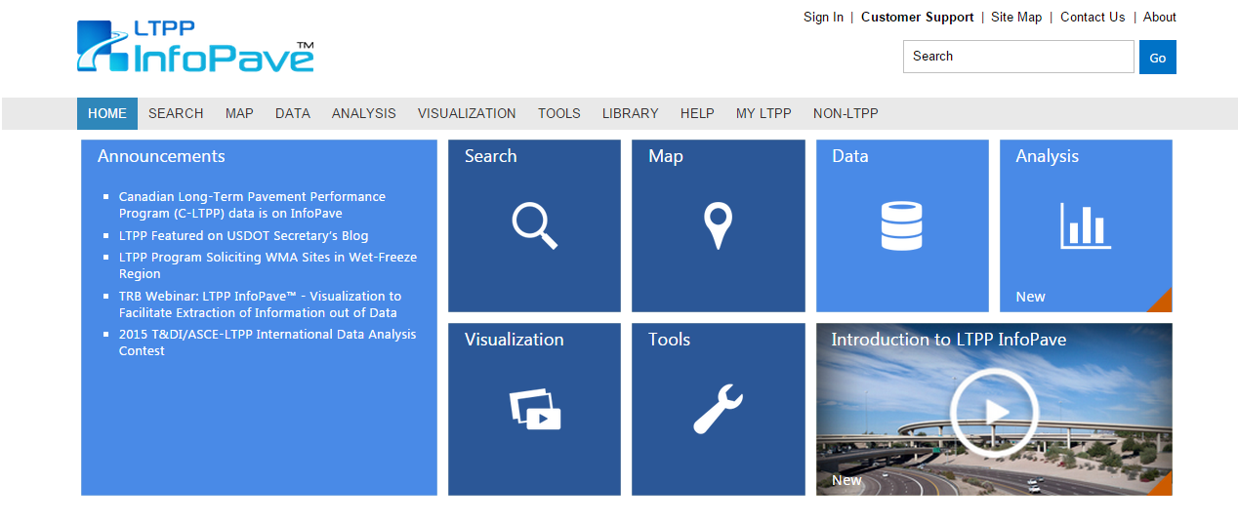
Thawing Index: Step 1...
www.InfoPave.com
Register or Sign in.

Slide 5
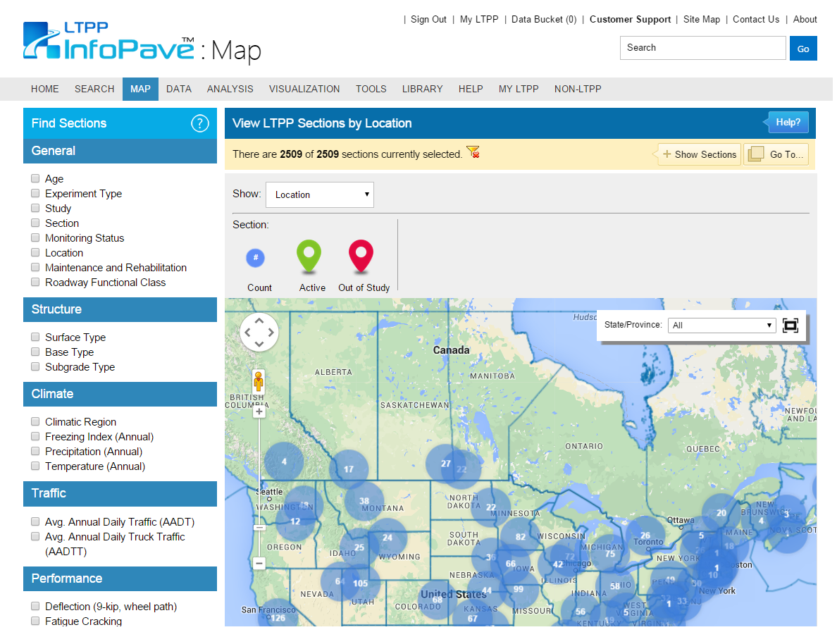
Thawing Index: Step 1...
www.InfoPave.com/Map/ByLocation/
Locate which sections pertain to your study.
Use filters to narrow search parameters.

Slide 6
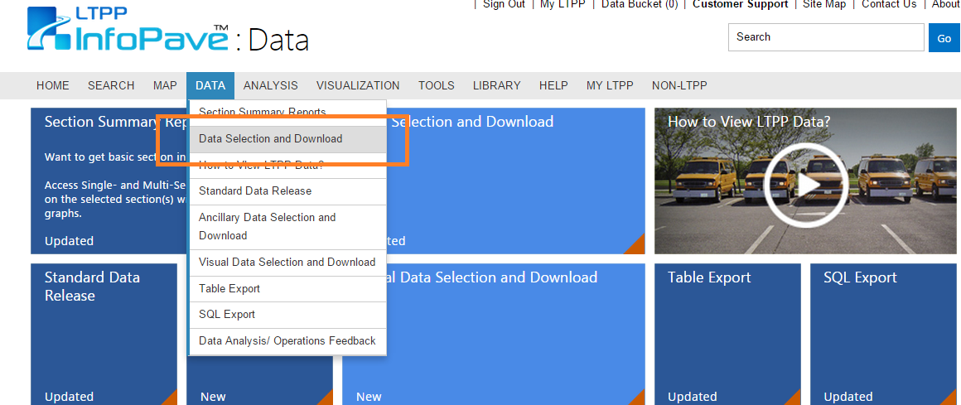
Thawing Index: Step 2
www.InfoPave.com/Data/DataSelection
Go to: Data Selection and Download

Slide 7
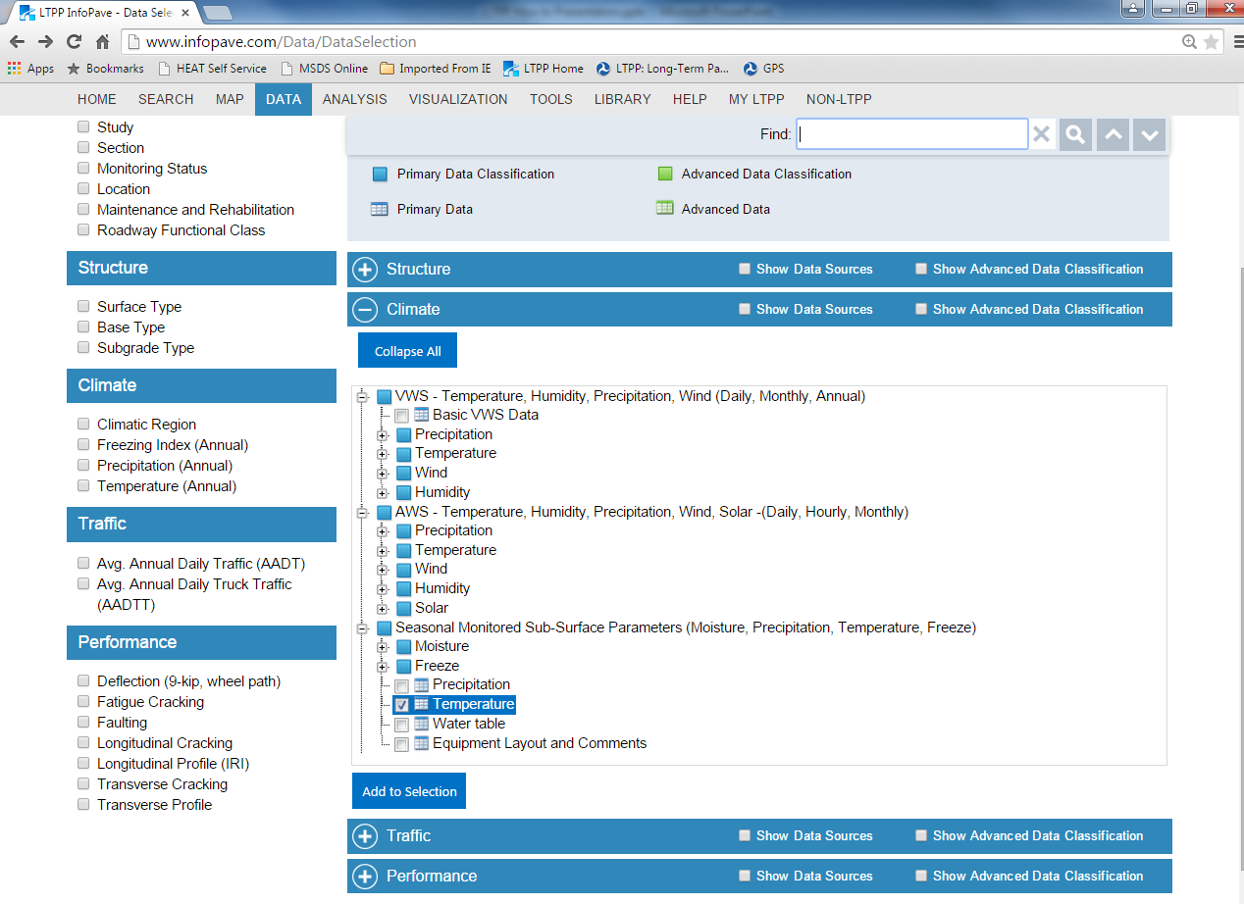
Thawing Index: Step 2...
www.InfoPave.com/Data/DataSelection
Expand “Climate” tab and select relevant temperature data.
Click “Add to Selection”

Slide 8
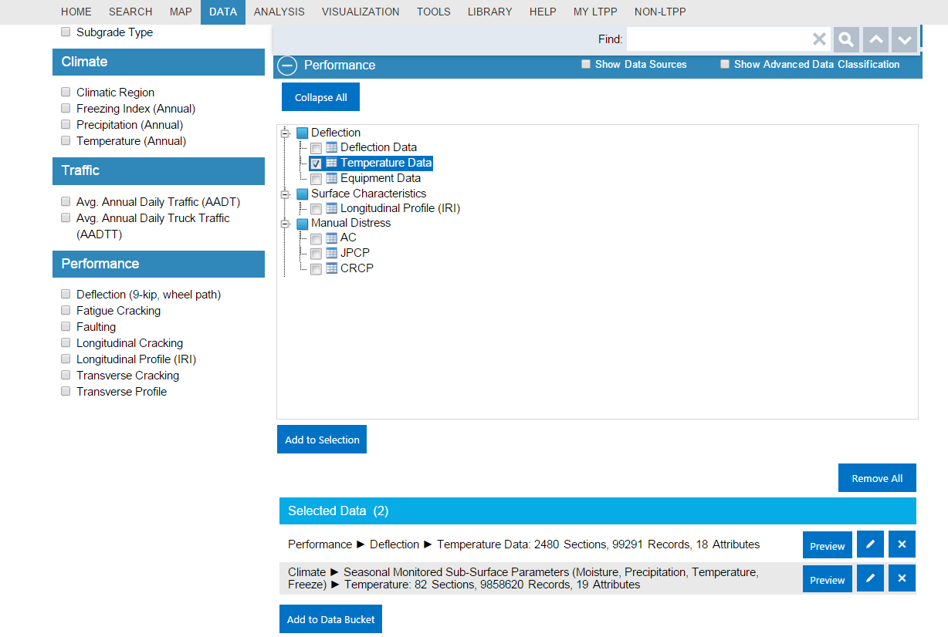
Thawing Index: Step 3
www.InfoPave.com/Data/DataSelection
Expand “Performance” tab and select relevant temperature data.
Click “Add to Selection”
Click “Add to Data Bucket”

Slide 9
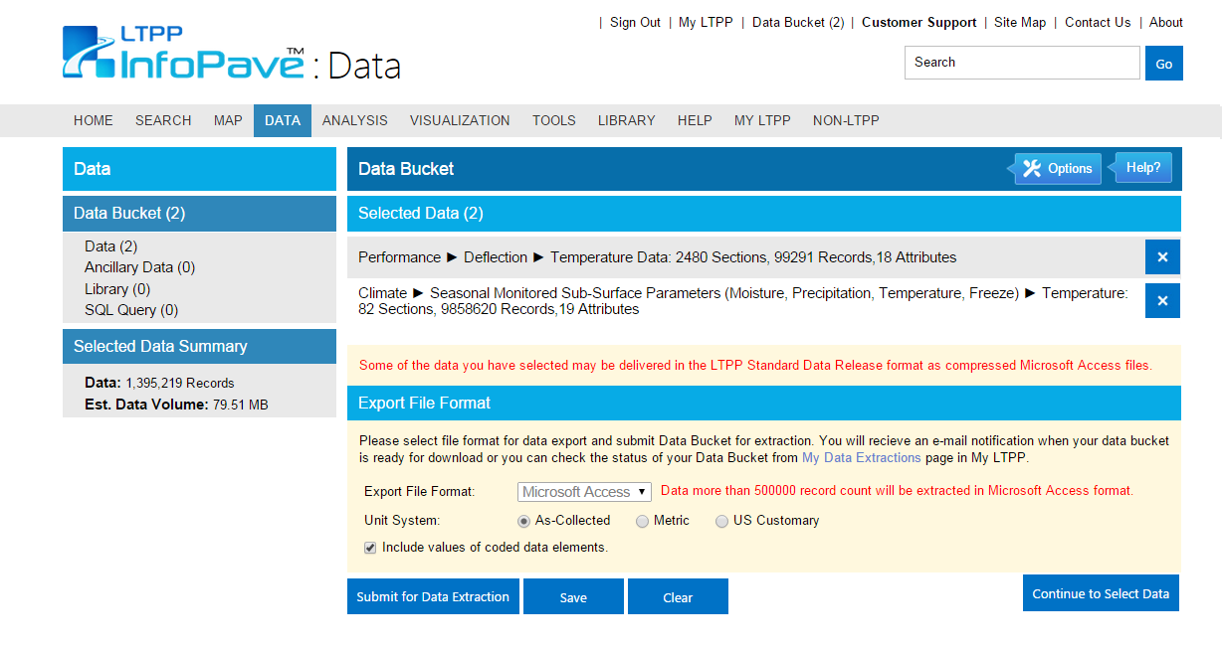
Thawing Index: Step 4
www.InfoPave.com/DataBucket/DataBucket
Select preferred export format.
Click “Submit for Data Extraction”

Slide 10
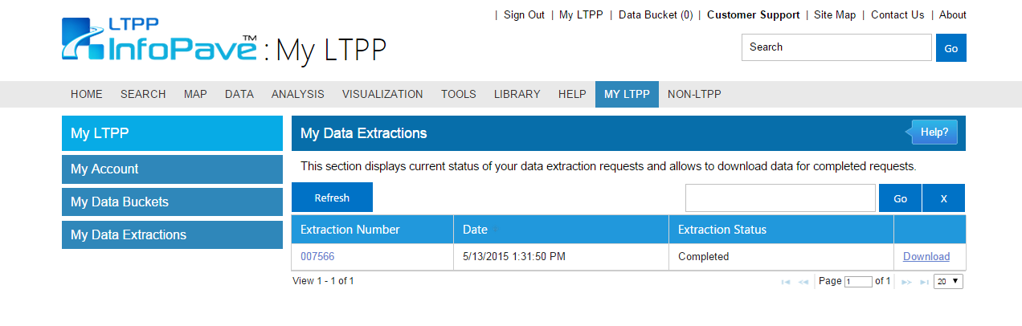
Thawing Index: Step 4…
www.InfoPave.com/MyLTPP/MyDataExtraction
Go to: My LTPP
Go to: My Data Extractions
Download & Compile given data.

Slide 11
Thawing Index: Step 5
Determine the reference temperature using the asphalt and air temperature data obtained from LTPP InfoPave.
The thaw index can be calculated throughout the year with the reference temperature. From this data the threshold thaw index can be determined.
TI = Σ (Average Daily Temperature – Reference Temperature)

Slide 12
Questions?

Slide 13
References
Patrick Leong, Susan Tighe, Guy Doré. Using LTPP Data to Develop Spring Load Restrictions: A Pilot Study. Paper Submitted to AISIM, Waterloo, Ont., August 2005
Long Term Pavement Performance. LTPP InfoPave. www.infopave.com.

